Slide 1
Product Tracking and Customer Management System
By Mike Juarez-Sweeney, Jerry Moua and Mohammad Shariff

Slide 2
Table of contents - Elaboration 2
Vision and Scope
Use Case Diagram
State Diagram
Sequence Diagrams
Domain Model and Class Diagram
Expert and Creator
Software Architecture
Data Model
Order Tracking and Discount Adapter
Sequence Diagrams
Customer
Administrator
Activity Diagrams
Customer View Products
Employee

Slide 3
Vision and scope

Slide 4
Vision and scope
Move customer traffic to company website

Slide 5
Vision and scope
Move customer traffic to company website
Detailed product information

Slide 6
Vision and scope
Move customer traffic to company website
Detailed product information
In depth customer service and help

Slide 7
Vision and scope
Move customer traffic to company website
Detailed product information
In depth customer service and help
Direct customer contact

Slide 8
Vision and scope
Move customer traffic to company website
Detailed product information
In depth customer service and help
Direct customer contact
Better inventory tracking

Slide 9
Vision and scope
Move customer traffic to company website
Detailed product information
In depth customer service and help
Direct customer contact
Better inventory tracking
Lower costs

Slide 10
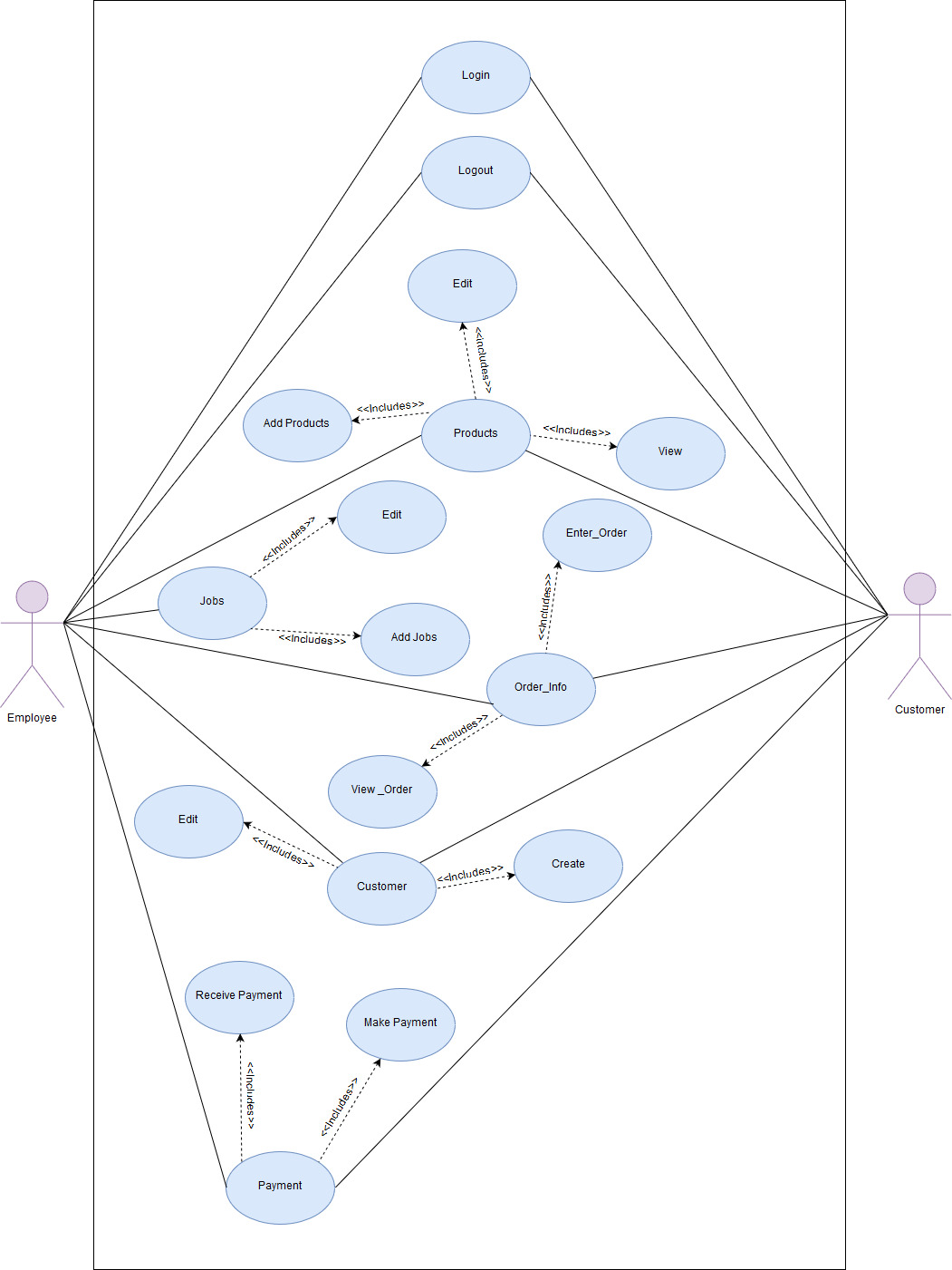
Updated Use Case diagram

Slide 11
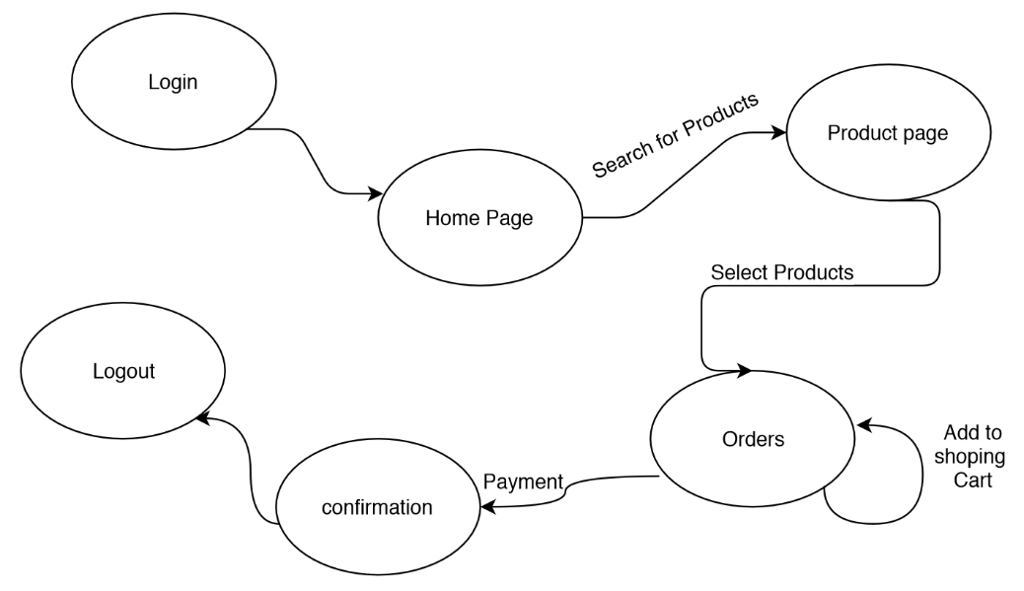
STATE MACHINE DIAGRAM: Customer buys products

Slide 12
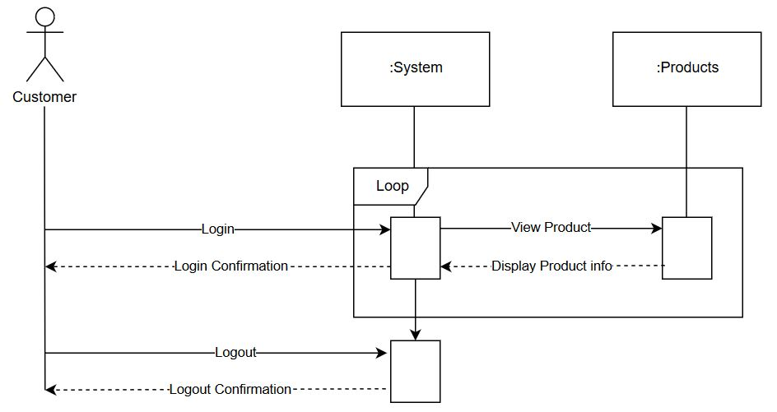
Sequence Diagram: Customer View Products Use Case

Slide 13
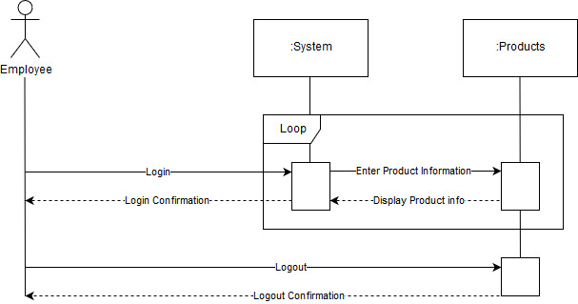
Sequence Diagram: Employee Enters Products Use Case

Slide 14
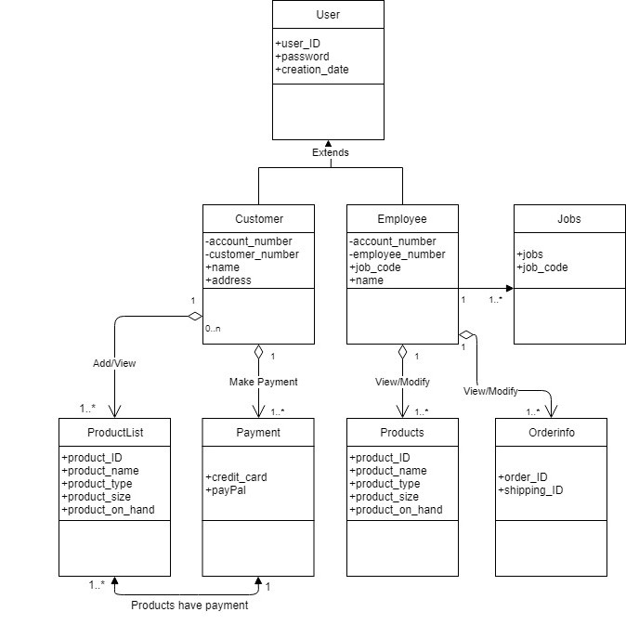
Domain model

Slide 15
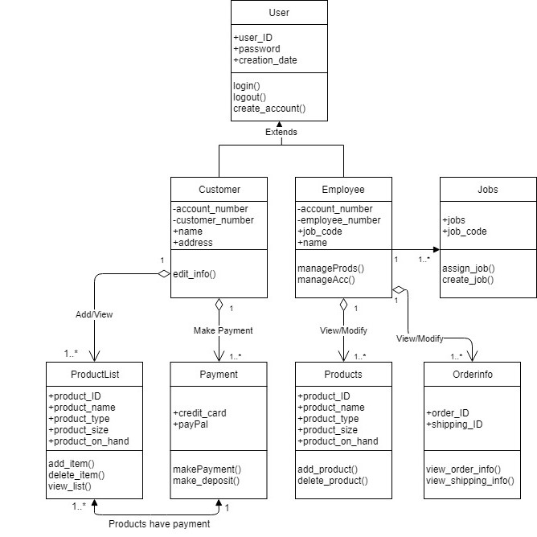
Class diagram

Slide 16
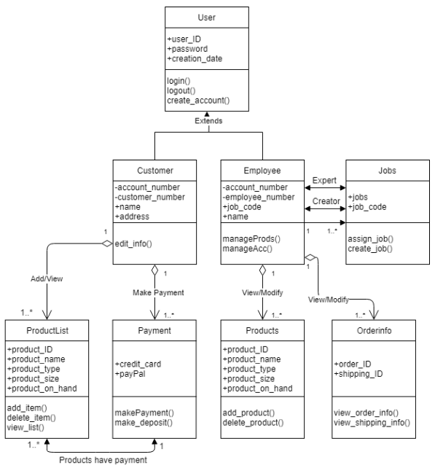
Expert and Creator
Employee is the expert of User
- Responsible for being account manager
Employee is the creator of User
- Employee will create the instances in User

Slide 17
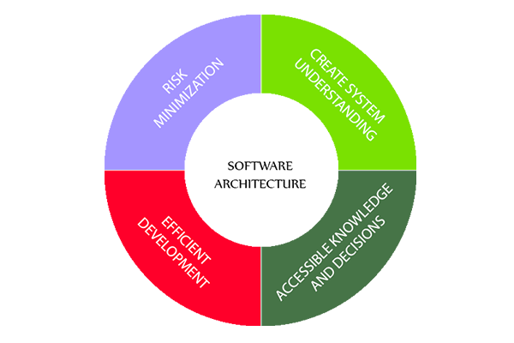
Software Architecture
Purpose
The primary purpose of the Product Tracking and Customer Management System is to satisfy the needs of companies that are seeking to streamline their products and attain a detailed customer database.

Slide 18
Software Architecture: Logical View
User Interface
Two actors:
A customer class that allows customers to view and add products in the system for purchase. An employee class that allows employees to view and edit the products in the system as well as track inventory and utilize customer and employee databases.

Slide 19
Software Architecture: Programming View
HTML, JavaScript, and CSS will be implemented in the front end design of this system. The database will be implemented in MySQL and PHP will handle the communication between the web application and the database. The system will be a web based application and can be accessed by both PC and Mobile Devices. The website will allow the customers to keep track of their orders and purchase products.

Slide 20
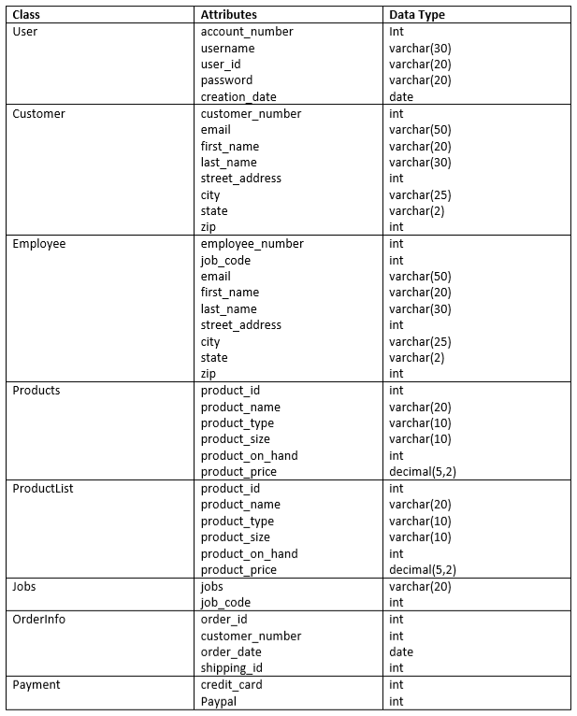
Data model

Slide 21
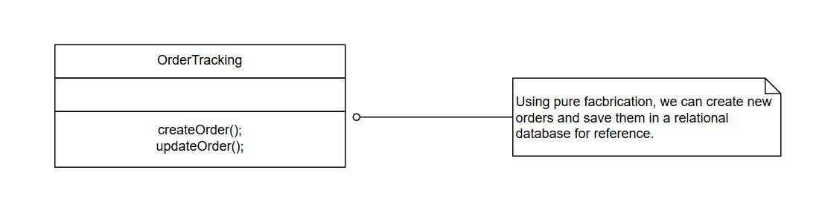
Tracking orders

Slide 22
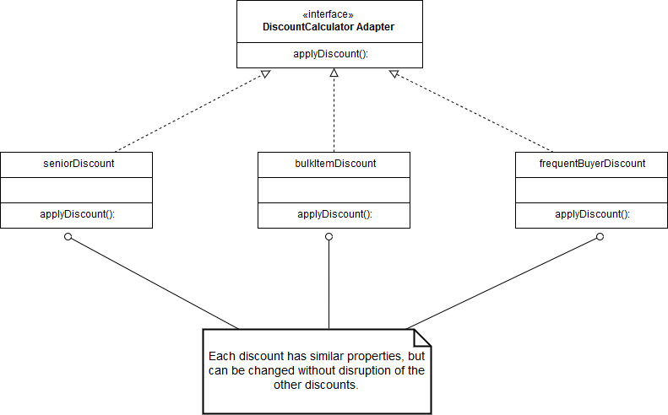
Discount Adapter

Slide 23
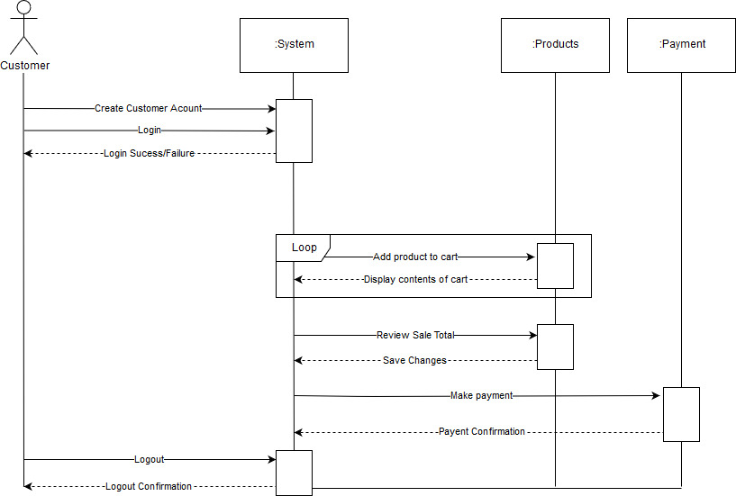
Sequence Diagram: Customer

Slide 24
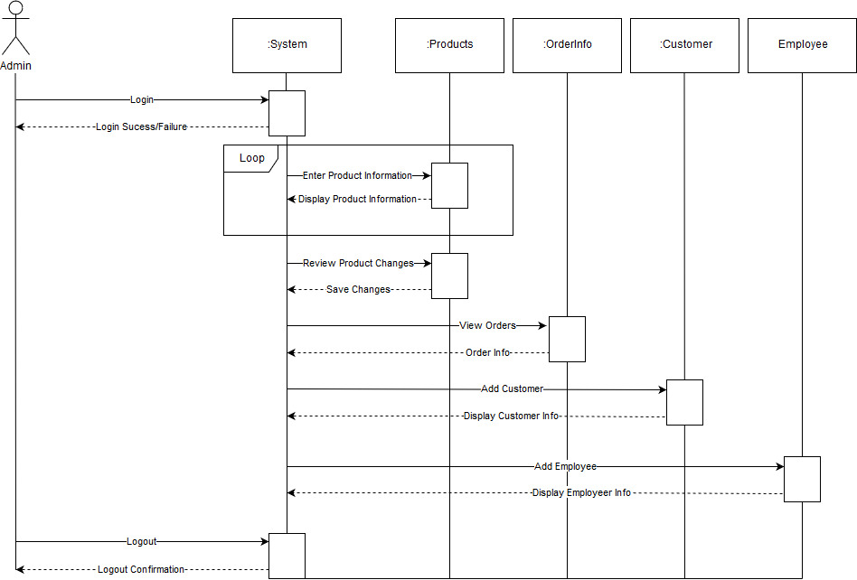
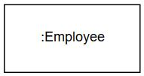
Sequence Diagram: Employee

Slide 25
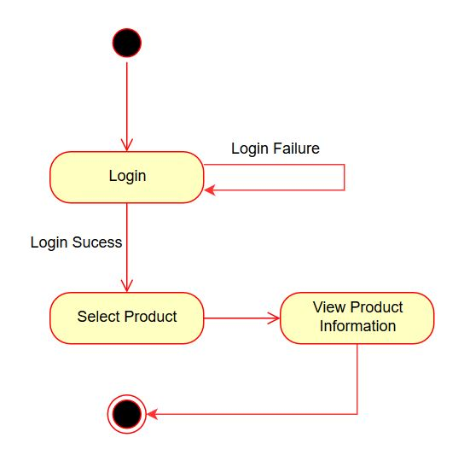
Activity Diagram: Customer View Products

Slide 26
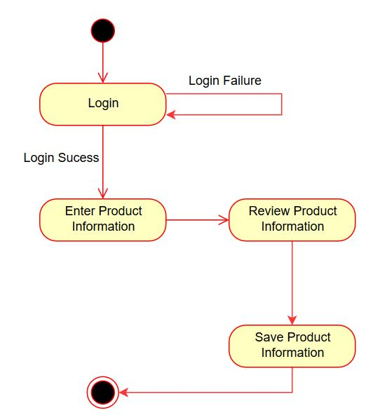
Activity Diagram: Employee Enters Products

Slide 27
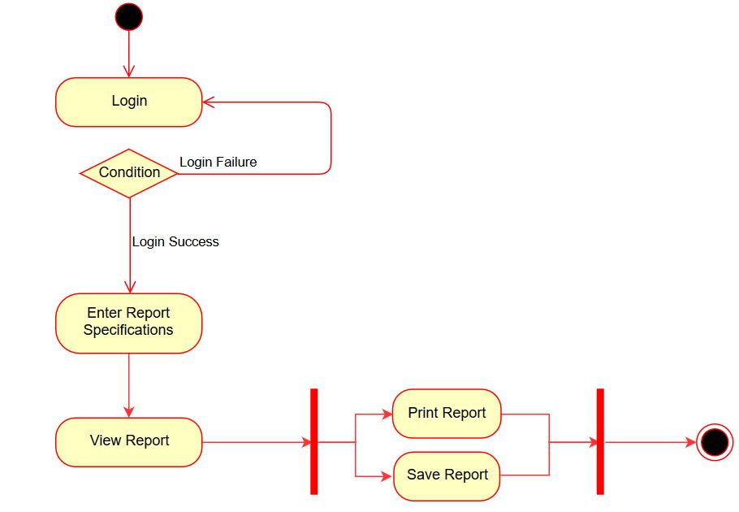
Sequence Diagram: Employee Generate Report

Slide 28
Prototype demo

Slide 29

Questions?

